Slide 1
Chapter 2
Intro to Reinforcement Learning
By Richard Sutton
12/2/19

Slide 2
Agenda/Announcements
Mailing List has been created and approved
drl-journal-club@ucdavis.edu
Finish the rest of Ch. 2 (2.5 – 2.10) by today
Start Ch. 3 & OpenAI Gym vs Kraggle discussion by next week or the beginning of next quarter?
Start literature research and implementation by next quarter
First meeting might be a recap of previous meetings and plan to move forward

Slide 3

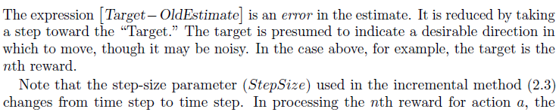
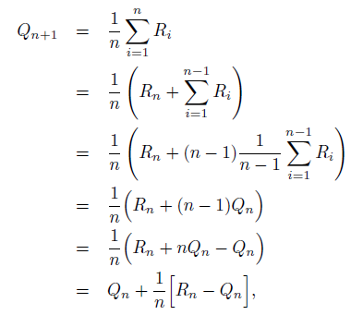
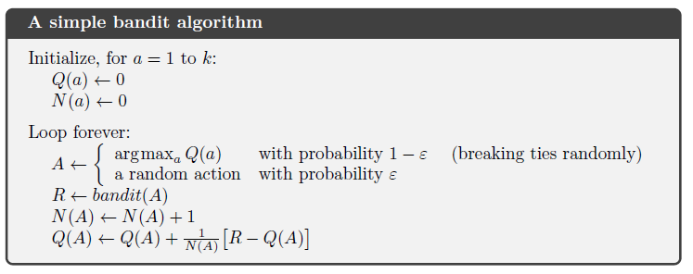
2.4 Incremental Implementation
Notes:
Way to estimate action value (more efficient way – saves memory by including only latest reward)

Slide 4
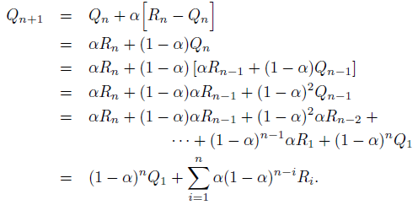
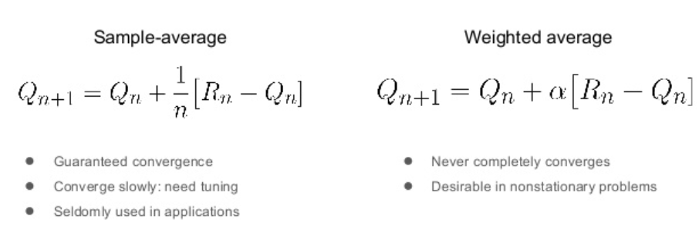
2.5 Tracking a Nonstationary Problem
Constant step-size parameter α.
Give more weight to recent rewards.
Notes:
In real life, it is common to find distributions that change over time. In this case, the problem gets harder to solve just because previous observations are less useful: they might not be reflecting the truth about the current state of the bandit.

Slide 5
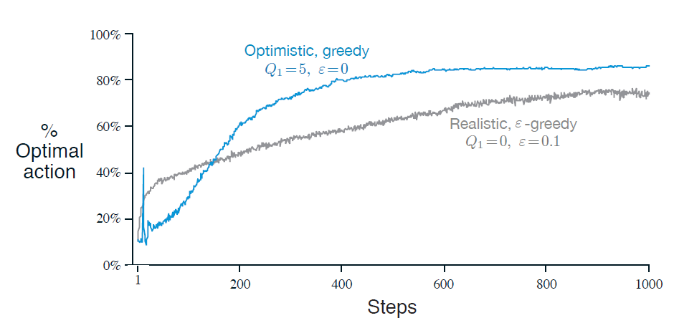
2.6 Optimistic Initial Values
Set initial action values optimistically (ex. +5).
Does not work in nonstationary problems because its drive for exploration is inherently temporary (if the task changes, creating a renewed need for exploration, this method cannot help).
Can be used to temporarily encourage exploration:
Notes:
In most of this chapter we have used sample averages to estimate action values because sample averages do not produce the initial bias that constant step sizes do
However, sample averages are not a completely satisfactory solution because they may perform poorly on nonstationary problems.
All the previous methods are dependent to some extent on the initial action-value estimates, $Q_{1}\left(a\right)$, so they are biased by their initial estimates. Downside is that the initial estimate must be pick by the user. Upside is that they provide prior knowledge about what level of rewards can be expected.
For sample-average methods, the bias disappears once all actions have been selected at least once.
For methods with constant α, the bias is permanent, though decreasing over time.

Slide 6
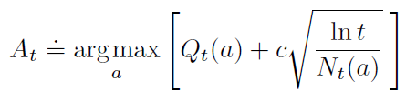
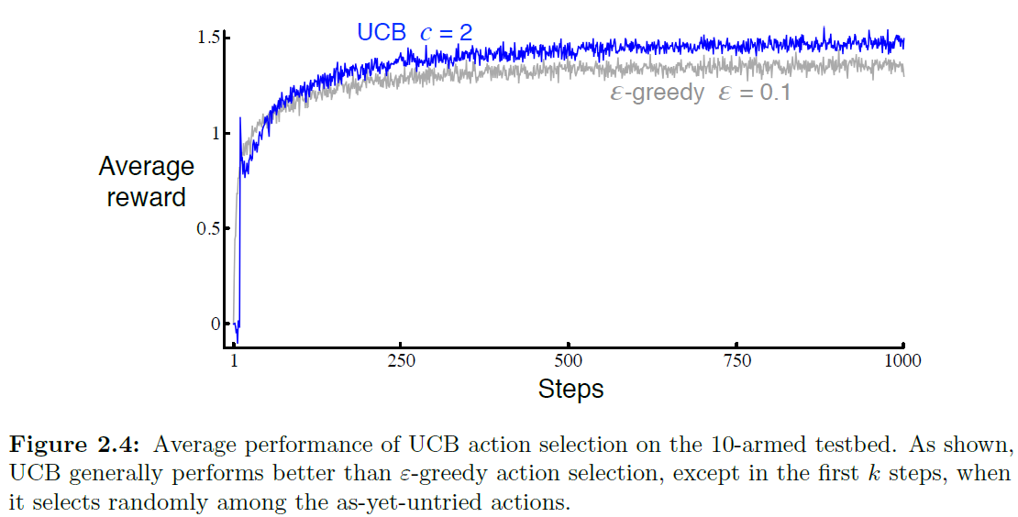


2.7 Upper-Confidence-Bound Action Selection
Random exploration gives us an opportunity to try out options that we have not known much about. However, due to the randomness, it is possible we end up exploring a bad action which we have confirmed in the past. To avoid such inefficient exploration, one approach is to decrease the parameter ε (ε-greedy) in time and the other is to be optimistic about options with high uncertainty and thus to prefer actions for which we haven’t had a confident value estimation yet. Or in other words, we favor exploration of actions with a strong potential to have an optimal value.
The Upper Confidence Bounds (UCB) algorithm measures this
potential by an upper confidence bound of the reward value
The use of the natural logarithm means that the increases get smaller over time, but are unbounded.
$N_{t}(a)$ denotes the number of times that action a has been selected.
C > 0 controls the degree of exploration .
The square-root term is a measure of the uncertainty or variance in the estimate of a’s value.
The quantity being max’ed over is a sort of upper bound on the possible true value of action a, with c determining the confidence level.
UCB often performs well, as shown here, but is more difficult than ϵ-greedy to extend beyond bandits to the more general reinforcement learning settings such as non-stationary problems.
Another difficulty is dealing with large state spaces, particularly when using function approximation.
In these more advanced settings the idea of UCB action selection is usually not practical.
Notes:
- Take into account each action’s potential to be optimal
Selected less → more potential
Difficult to extend beyond multi-armed bandits
Larger number of trials N(a) gives as smaller bound Ut(a)
Now, the question is how to estimate the upper confidence bound.

Slide 7
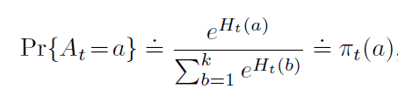
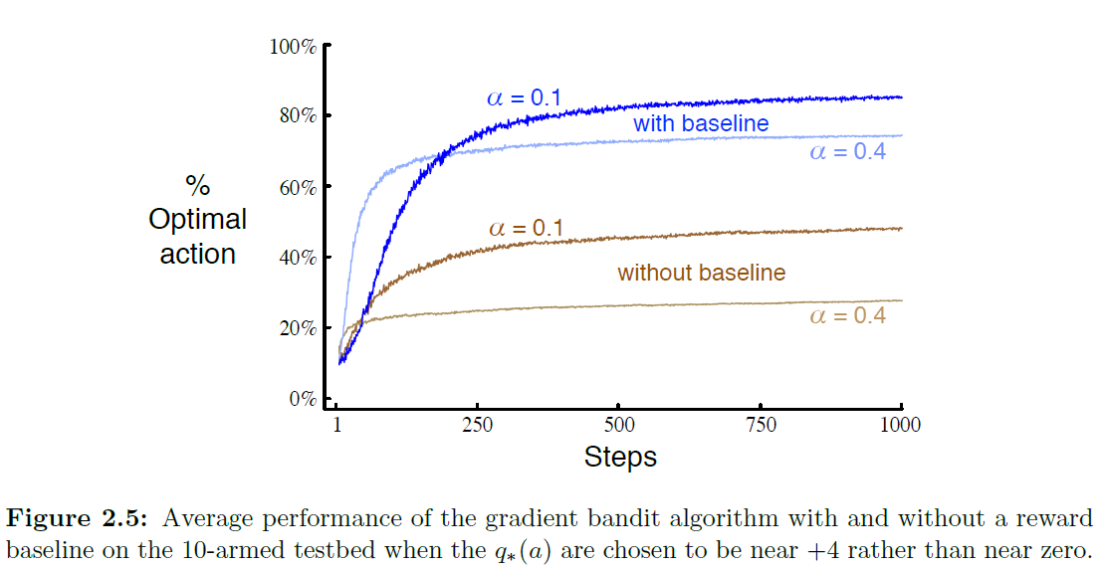

2.8 Gradient Bandit Algorithms
This is another method that estimate action values and use those estimates to select actions.
Learn a numerical preference, $H_{t}(a)$, for each action which causes it to select the higher preference actions more frequently.
The preferences are calculated using a soft-max distribution:
Gradient bandit algorithm is an instance of stochastic approximation to gradient ascent.
This algorithm has robust convergence properties. For example, we could have set it to zero, or to 1000, and the algorithm would still be an instance of stochastic gradient ascent.
The choice of the baseline does not affect the expected update of the algorithm, but it does affect the variance of the update and thus the rate of convergence
Choosing it as the average of the rewards may not be the very best, but it is simple and works well in practice
Notes:
Gradient bandit algorithms estimate not action values, but action preferences, and favor the more preferred actions in a graded, probabilistic manner using a soft-max distribution
Pi(a) = the probability of taking action a at time t

Slide 8
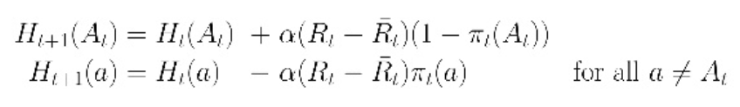

2.8 Gradient Bandit Algorithms: Stochastic Gradient ASCENT
Update preference $H_{t}\left(a\right)$ with SGA
Baseline $\overline{R_{t}}$: average of all rewards $R_{1}, R_{2},…, R_{t}$
Increase probability if reward is above baseline
Decrease probability if reward is below baseline
Notes:
Gradient bandit algorithms estimate not action values, but action preferences, and favor the more preferred actions in a graded, probabilistic manner using a soft-max distribution
Pi(a) = the probability of taking action a at time t

Slide 9

2.9 Associative Search (Contextual Bandits)
Observe some context that can help decision
Intermediate between multi-armed bandit and full RL problem
Need to learn a policy to associate observations and actions
Each action only affects immediate reward
Example: Suppose you are facing an actual slot machine that changes the color of its display . Now you can learn a policy associating each task, signaled by the color you see, with the best action to take when facing that task—for instance, if red, select arm 1; if green, select arm 2as it changes its action values.
Notes:
Associative Search task (or Contextual Bandits) involves both trial-and-error learning to search for the best actions, and association of these actions with the situations in which they are best.
Example 1: Suppose you are facing an actual slot machine that changes the color of its display . Now you can learn a policy associating each task, signaled by the color you see, with the best action to take when facing that task—for instance, if red, select arm 1; if green, select arm 2as it changes its action values.
Example 2: Suppose you face a 2-armed bandit task whose true action values change randomly from time step to time step. Specifically, suppose that, for any time step, the true values of actions 1 and 2 are respectively 0.1 and 0.2 with probability 0.5 (case A), and 0.9 and 0.8 with probability 0.5 (case B). If you are not able to tell which case you face at any step, what is the best expectation of success you can achieve and how should you behave to achieve it? Now suppose that on each step you are told whether you are facing case A or case B (although you still don’t know the true action values). This is an associative search task.
Associative search tasks are intermediate between the k-armed bandit problem and the full reinforcement learning problem. They are like the full reinforcement learning problem in that they involve learning a policy, but like our version of the k-armed bandit problem in that each action affects only the immediate reward.
If actions are allowed to affect the next situation as well as the reward, then we have the full reinforcement learning problem.

Slide 10
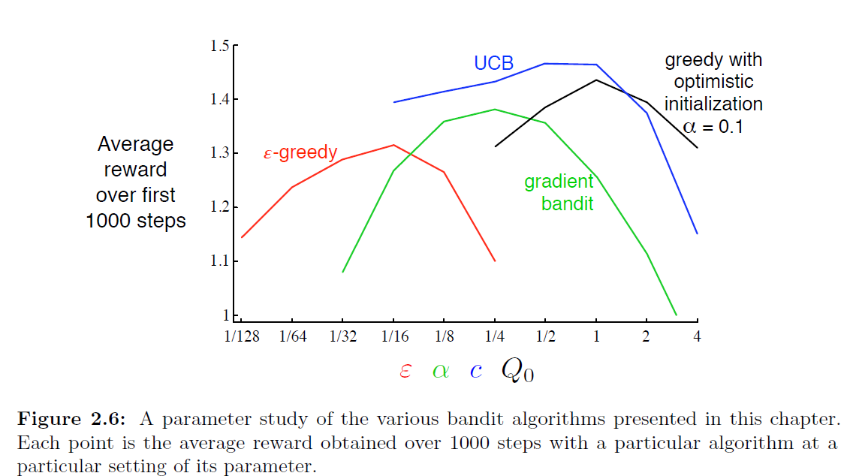
2.10 Summary
Check performance in best setting
Check hyperparameter sensitivity
parameter study
All of these algorithms are fairly insensitive, performing well over a range of parameter values varying by about an order of magnitude.
The ϵ-greedy methods choose randomly a small fraction of the time.
UCB methods choose deterministically but achieve exploration by subtly favoring at each step the actions that have so far received fewer samples.
Gradient bandit algorithms estimate not action values, but action preferences, and favor the more preferred actions in a graded, probabilistic manner using a soft-max distribution
Notes:
A complication is that they all have a parameter; to get a meaningful comparison we have to consider their performance as a function of their parameter.
Our graphs so far have shown the course of learning over time for each algorithm and parameter setting, to produce a learning curve for that algorithm and parameter setting.
If we plotted learning curves for all algorithms and all parameter settings, then the graph would be too complex and crowded to make clear comparisons. Instead we summarize a complete learning curve by its average value over the 1000 steps; this value is proportional to the area under the learning curve. Figure 2.6 shows this measure for the various bandit algorithms from this chapter, each as a function of its own parameter shown on a single scale on the x-axis. This kind of graph is called a parameter study. Note that the parameter values are varied by factors of two and presented on a log scale.

